Slide 1
LAVOSAR Dissemination Workshop
EDA, Brussels, 3rd June 2014
Dr. Norbert Härle
Rheinmetall Defence Electronics - Head of Technology Strategies
( phone: +49 421 457-1503 Ê fax: +49 421 457- 4415 È mobile: +49 151 14805589 * e-mail: Norbert.Haerle@Rheinmetall.com

Slide 2
Workshop Agenda
Time | Topic
1000 – 1015 | Introduction by the EDA (Marek Kalbarczyk, 15min)
1015 – 1030 | LAVOSAR Study Overview (Norbert Härle, 15min)
1030 – 1200 | Presentation of Selected Topics from the Study: Analysis of Background Material (George Valsamakis, 10min) Information Collection from Stakeholders (Norbert Härle, 10min) Normative Framework (Norbert Härle, 15min) Business Case and Roadmap (Richard Lynch, 20min) Operational Aspects (Norbert Härle, 5min) Standards (Richard Lynch, 10min) Technologies (Norbert Härle, 20min)
1200 – 1300 | Lunch break
1300 – 1430 | Presentation of Selected Topics from the Study: Integrated Mission System (Norbert Härle, 40min) Specification and Design Guidelines (Richard Lynch, 20min) Security and Safety (George Valsamakis, 15min) System Acceptance Framework (Daniel Ota, 15min)
1430 – 1445 | LAVOSAR Recommendations (Norbert Härle, 15min)
1445 – 1500 | Final Discussion, Summary and Way Ahead (Norbert Härle, 15min)

Slide 3
General

Slide 4
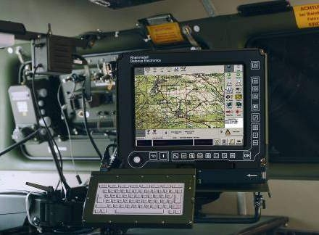

General
- Motivation
  permanent and increasing need for networked information technology in military land vehicles
    enable better situational awareness and
    faster, more efficient and precise effects
  number of national projects underway that aim to standardise certain information technology features in order
    to manage complexity and
    to provide a coordinated approach at European level
      to future procurement and
      to whole life equipment support.
  previous land vehicle studies at EDA
  LAVOSAR
    a study of the technical and financial aspects of a common European Land Vehicle approach to Mission System open architecture would be worthwhile
    focussing on the mission systems of typical vehicles to be used by participating member countries.

Slide 5
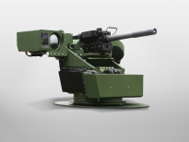
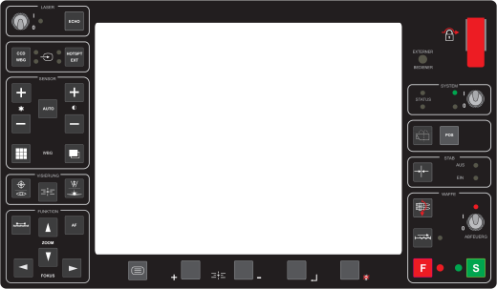
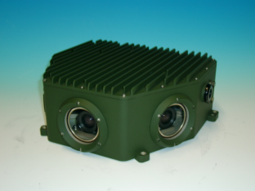
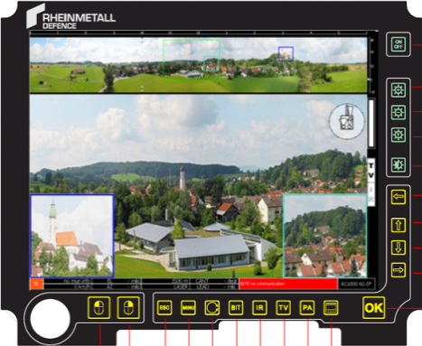
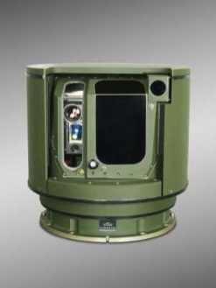
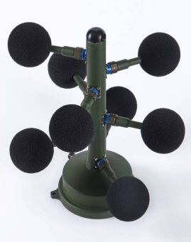
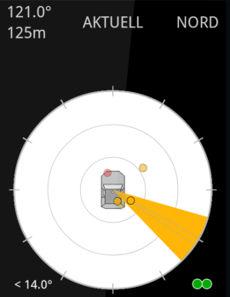
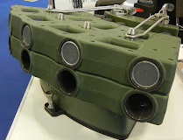
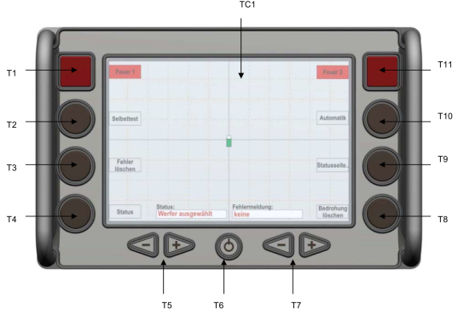
General
- Mission System Examples
System 1: E/O Panoramic Sensor System
System 2: E/O Sector Sighting System
System 4: Remote Controlled Weapon Station
System 3: Acoustic Sniper Detection
System 5: Obscuring Systems

Slide 6
General
- Aims & Objectives
  Objective is
    to define an electronic and information reference architecture for military land vehicles
    to be published and proposed as Land Vehicle Open Architecture for Mission Systems
    architecture
      shall serve as a reference solution for developing and implementing mission systems for vehicles
      is for integrating the mission subsystems into a completely networked and configurable vehicle capability depending on the vehicle type or mission requirement.
  Study makes recommendations for the developement of a commonly agreed Open Reference Architecture for Military Land Vehicle Mission Systems by proposing a first comprehensive approach to an electronic and information framework architecture and a roadmap for implementation
  Tasks
    Analyse Standards and Best Practices, current and potential future Technologies and other activities in the domain having applicability to an open electronic mission system.
    Create a Normative Framework containing agreed definitions of context and terminology as a basis for more detailed study.
    Study and develop a functional and technical Mission System architecture, making recommendations to form the basis of a common approach used by multiple member states in Europe.
    Study and develop a Business Case supporting an Open Architecture approach.

Slide 7
General
- Definition
Open Reference Architecture
  Comprehensive best practice architecture with all necessary views from which a target architecture for a specific system can be derived (and which is maintained by an open, public consensus process of an open forum).
  There are no barriers to implementation by a third party:
    No Secrets: MUST include all details necessary for implementation.
    Availability: MUST be freely and publicly available (e.g., from a stable web site) under royalty-free terms.
    Patents: All patents essential to implementation MUST:
      be licensed under royalty-free terms for unrestricted use, or
      be covered by a promise of non-assertion when practiced
    No Agreements: There MUST NOT be any requirement for execution of a license agreement, NDA, grant, click-through, or any other form of paperwork, to deploy conforming implementations.
    No Incompatible Dependencies: Implementation MUST NOT require any other technology that fails to meet the criteria above.

Slide 8
General
- Benefits of an Open Reference Architecture
By standardizing the architecture across Europe, a number of benefits will be provided:
  integration of sub-systems into a single integrated Mission System
  reduced vendor lock in,
  greater competition,
  improved ability to re-role vehicles,
  improved insertion of new technology,
  reduced technical risk,
  reduced operator and maintenainer training,
  facilitated sharing of equipment during international common missions,
  decreased cost of system engineering and integration, verification and validation costs, and
  enabled greater system innovation.

Slide 9
General
- Project Facts
Partners and Experts Involved:
  Fraunhofer-Institut für Kommunikation, Informationsverarbeitung und Ergonomie FKIE (Germany)
    Daniel Ota
    Ralph Erdt
  Rheinmetall Defence Electronics (Germany)
    Dr. Norbert Härle
    Dr. Oliver Prenzel
  Selex ES Limited (United Kingdom)
    Guy Davies
    Edouard John Louis Mouchel
  Thales Communications and Security (France)
    Olivier Schmidt
  Thales Ltd. (United Kingdom)
    David Kempton
  Thales SA
    Benoit Senechal
  Vetronics Research Centre (United Kingdom)
    Professor Elias Stipidis
    Dr. George Valsamakis
    Dr. Aditya Deshpande
Contracting
  Contracting Agency
    European Defence Agency (EDA)
  Contract Number
    12.R&T.OP.336
  Project Duration
    1 Feb. 2013 - 31 Jan. 2014
  Budget
    Total: 345K€
  Contact
    Dr. Norbert Härle
    (Norbert.Haerle@Rheinmetall.com)
9

Slide 10
Study Execution

Slide 11
Study Execution
- Study Organisation

Slide 12





Slide 13

Workshops & Briefings
Deliverable | Date / Place | Description
Workshop 1 | 23-04-2013 EDA | Workshop with government officials from the procurement and maintenance departments of the Ministries of Defence of all EDA participating Member States. Aim: Information about project and first outcomes Refinement of initial Work Package 1 results (Normative Framework, Best Practices and Standards, Business Case and Roadmap) Collection requirements and ideas
Workshop 2 | 25-06-2013 EDA | Workshop with platform manufacturers system integrators equipment suppliers Aim: Information about project and outcomes to date Refinement of Work Package 1 results (normative framework, best practices and standards, business case and roadmap) Refinement of Work Package 2 results (computing and communication technologies, mission system technologies, current architectural structures, forecasts) Input to Work Package 3 (current and potential future architectural structures)
Briefing 1 | 04-04-2013 EDA | Briefing to EDA Industry Standardization Conference
Briefing 2 | 17-09-2013 Munich | Briefing to Military Vetronics Association (MilVA)
Briefing 3 | 25-09-2013 EDA | Briefing to EDA Future Land System Experts Working Group
Briefing 4 | 26-09-2013 EDA | Briefing to EDA Materiel Standardization Group (MSG) and Materiel Standardization Harmonization Team (MSHT)

Slide 14
Study Results
Analysis of Background Material

Slide 15
Study Results - 1. Analysis of Background Material
- Other Activities
Other activities with Relevance to LAVOSAR
  Vehicle System Integration (VSI)
  Generic Vehicle Architecture (GVA)
  STANAG “NATO Generic Vehicle Architecture” (NGVA)
  Vehicle Integration for C4ISR-EW Interoperability (VICTORY)
  SCORPION
  AUTomotive Open System Architecture (AUTOSAR)
  CEN Workshop 10, Expert Group 9, Armoured Land Vehicle Technology
  EDA Future Land Systems Expert Group
  EDA Expert Group 20 on System Architectures
  Future Airborne Capability Environment (FACE™)
  European Network Enabled Armoured Fighting Vehicle (ENEA)

Slide 16
Study Results - 1. Analysis of Background Material
- Summary
  Previous European studies had focussed on vehicles rather than the mission system.
  Formal definitions of a generic Mission System as applicable to land vehicles were not found amongst the background material.
  The aerospace concepts from the FACE programme were identified as a good input for the software aspects.
  UK GVA was considered as very relevant, with scope for additional standardisation of software architecture. (LAVOSAR could usefully build upon and complement GVA through addition of software aspects).
  VSI (incl. the metrics document) provided a relevant basis for LAVOSAR.
  The French SCORPION and US VICTORY programmes, whilst suspected of including relevant concepts, could not be analysed as neither provides open documentation.
  (NGVA was just in its infancy and not developed far enough when the study was undertaken in order to influence LAVOSAR.)

Slide 17
Study Results
Information Collection from Stakeholders

Slide 18
Study Results - 2. Information Collection from Stakeholders
- Government Workshop
  Time and Place: 23-04-2013, EDA Brussels
  Present were AT, DE, EDA, IT, SE
  Intermediate study results from “Standardisation and Business Case” presented
  Extract of Workshop Results
    Impact of the Open Architecture on Logistics, Interfaces, Production, Training and Maintenance shall be considered.
    Information Exchange
      role specific local situation picture
      exchange of battle management information to be decided by the commander
      role specific information directly interchangeable with the same role of another vehicle (bypassing the commander, e.g. traffic information, status of bridges, etc.)
      exchange of information in vincinity with other vehicles is important (also bypassing the commander, groupware)
    Comprehensive Safety and Security Concept is key to Open Architecture
    Possibility of three vehicle security domains (incl. gateways between them) required (secret, restricted, unclassified). Probably even more (mission restricted, mission secret)

Slide 19
Study Results - 2. Information Collection from Stakeholders
- Industry Workshop
  Time and Place: 25-06-2013, EDA Brussels
  Forty participants from ten countries and 35 organisations (industry and government) attended and discussed the presented approach
  Intermediate work results from “Standardisation and Business Case”, “Technologies” and first results on the “Architecture” presented
  Links
    Official invitation: http://www.eda.europa.eu/info-hub/events/2013/05/03/industrial-workshop-open-system-architecture-standardisation
    Workshop results: http://www.eda.europa.eu/info-hub/news/2013/07/04/lavosar-workshop-results
  Substantial interest and regarded as key information technology on military vehicles
  Workshop Results
    Good feedback collected
    Some companies were trying to push legacy technology

Slide 20
Study Results - 2. Information Collection from Stakeholders
- Questionaires
  Goverment Experts
    procurement, concepts for support and training,required mission system features or mission subsystems, information and power exchange requirements
    Main Battle Tank (MBT), Infantry Fighting Vehicle (IFV), Recce, All Purpose Carrier (APC) & Truck
  Industry - Standards and Best Practices (distributed to LAVOSAR team, Nexter, Patria, MILVA, EDA FLSG)
    crew stations, embedded systems, built-in-tests and health and usage monitoring systems, vetronics, network infrastructures, power infrastructures, mechanical infrastructures, safety, security, EMC and support infrastructures
  Industry - Technologies (distributed to LAVOSAR team, Nexter, Patria, MILVA, EDA FLSG)
    computing, operating system, middleware, network infrastructure, communications, security, safety

Slide 21
Study Results - 2. Information Collection from Stakeholders
- Government Questionnaire

Slide 22
Study Results - 2. Information Collection from Stakeholders
- External Interface Priority - All Purpose Combat Vehicle Type
Information & Power Exchange Requirements | Voice | Low Speed Data | High Speed Data | Power
Own Vehicle - Dismounted Soldier | 3 | 2 | 2 | 3
Own Vehicle - Troop Vehicle | 3 | 3 | 3 | 3
Own Vehicle - Command Network | 4 | 3 | 3 | 3
Own Vehicle - Maintainer | 2 | 2 | 2 | 2
Own Vehicle - Training Equipment / Training Environment | 4 | 2 | 3 | 2
Own Vehicle - Dismounted Equipment (unmanned, static) | 2 | 2 | 2 | 2
Own Vehicle - UAV/UGV (eg video downlink) | 1 | 1 | 3 | 1
Own Vehicle - Internet | 1 | 1 | 1 | 1
Own Vehicle - Removable Storage Media | 1 | 2 | 2 | 1
Own Vehicle - Key material | 1 | 2 | 2 | 1

Slide 23
Study Results - 2. Information Collection from Stakeholders
- Technology Questionnaire
Domains | Categories | Most cited Today's Technology | Future Technology
Computing | CPU technologies | x86, Atom, i7, Xeon/Itanium | High end processor for high data rate processing. Low power consumption (Atom, ARM…)
 | Operator interfaces | Joystick | Emerging Multi-Function Consoles
 |  | Panel PC
 | Storage | SSD memory (Flash).
 | Device IO | CANBus (J1939 or CANOpen). | More Ethernet
 |  | Ethernet
Operating system | OS for console | Windows
 | OS for embedded computer or effectors | Linux | Towards Linux
 | Hypervisor | VMWare
Middleware | DDS, CCM, SOA, etc | DDS
Network Infrastructure | Data network infrastructure | Gigabit Etherent | 10Gigabit Etherent
 | Audio network infrastructure | VoIP
 | Video network infrastructure | Digitized over Ethernet | H264 compression
Communications | type of bearers | VHF
 | Communication server / gateway |  | Multiband radios & communication servers
Security | Security technology | Firewalls | Multi-Level Security (when mature technology is available)
 | security architecture | Independent networks
Safety | type of safety 'bus' | redundant CAN | Dedicated MilCAN

Slide 24
Study Results - 2. Information Collection from Stakeholders
- Summary
  Project team interaction with external stakeholders proved valuable and constructive, although the Government Workshop lacked representation by many member states.
  The Industry Workshop was very successful and industry interest was high.
  It was difficult to get responses to the questionnaires. (In future, these would benefit from more guidance information to ensure answers were provided in a consistent way.)
  No estimates of procurement quantities or timescales were provided by member states which made business modelling very difficult.
  Government inputs tended to prioritise many features of the Mission System as top priority, making it difficult to extract guidance for system architectural trades.
  The importance of Voice communication and C4I was universally highlighted.
  The standards and technology identification questionnaires released for external input did not deliver information beyond what was available within the team.

Slide 25
Study Results
Normative Framework

Slide 26
Study Results - 3. Normative Framework
- Influencing Factors

Slide 27
Study Results - 3. Normative Framework
- Mission System Context

Slide 28
Study Results - 3. Normative Framework
- Mission System Users

Slide 29
Study Results - 3. Normative Framework
- Use Case Identification

Slide 30
Study Results - 3. Normative Framework
- Mission System Composition

Slide 31
Study Results - 3. Normative Framework
- Sensors

Slide 32
Study Results - 3. Normative Framework
- Effectors

Slide 33
Study Results - 3. Normative Framework
- Non-Lethal Effectors

Slide 34
Study Results - 3. Normative Framework
- Mission System Infrastructure

Slide 35
Study Results - 3. Normative Framework
- Summary
  The Normative Framework effort was useful in establishing mission system context and terminology both within and external to the project.
  Many of the classes of Mission System components were adopted as the basis of the System Architecture.
  UML “Actor” and “Use Case” notation helped normalise the team concerning users and usages of the mission system.
  Lack of some government information made it difficult to make statements in the normative framework (fleet requirements and sizes, whole life support and training) that were expected to be used to support business case justifications.
  Lack of input on information future security concepts, within and amongst potentially collaborating European armies, prevented the planned “requirement driven” approach to security architecture.
  Analysis of EDA FLS Study identifies Combat Multi-Role Vehicle as major candidate for short term and long term benefit with respect to LAVOSAR.

Slide 36
Study Results
Business Case for an Open Reference Architecture

Slide 37
Study Results - 4. Business Case
- Military Land Vehicle Market Trends
  Frequent variation in theatre of operation and mission requirements
    ever evolving asymmetric and operational threats and urgent operational requirements (UORs)
    vehicles need to be rapidly reconfigurable.
    greater portability of designs is required.
  Shrinking EU defence procurement budgets
    fewer new vehicles being developed
    mission system upgrades to legacy fleets
  Increasing vetronics sophistication
    increased electronic complexity
    mission system integrators team or subcontact with specialist companies
    buyers are becoming averse to single source primes
  Continuous technology progession
    Fast innovation cycles in Information Technology, Sensors, and Electronics fuel buyer expectation of increased vehicle capability
    solution needed that enables affordable technology upgrades
    COTS or “plug-and- play” approach.
  Standardisation
    UK GVA influences the selection of some standard interfaces and standardisation initiatives are starting to accelerate.
    Software Standard for Military vehicles would open up the market and provide numerous benefits.

Slide 38
Study Results - 4. Business Case
- Benefits
“Tier 0” Government and Military
  User
    Improved task effectiveness
    Standard User-Interfaces
    Modular reconfigurability and re-use
    Simplified, faster training
  Procurement Agency (eg fleet 5000 vehicles)
    Stable, State-of-the-Art Components at Competitive Prices
    Easy Software / Electronics Upgrades
    Simplification of Specification
    Initial Acquisition (~10% potential saving)
    Support
    Training
    Whole life – potential saving initial estimate ~25%
“Tier 2” Supply Base
    Mission Sub-System with Standard Interface to be provided to a large number of System Integrators
    New Suppliers for Software (Seperate from Hardware Suppliers) may even directly interface with Tier 0
“Tier 1” Industry Prime and Mission System Integrator
  C4I System Integrator
    European rationalisation of fleet C4I interfaces,
    Reduction in proliferation of bespoke interface protocols and adaptation cost,
    Interoperability (Soldier-Vehicle-Base) enabled by a consistent net centric architecture,
    Improved network performance (relay node possibilities),
    Reduced vehicle adaptation cost.
  Mission System Integrator
    Simplified Integration, Testing, Certification
    Reduced risk
    Re-use of Solutions (also Software)
  Vehicle Provider
    Only one type of Infrastructure (according to the Standard) to be provided for Mission System

Slide 39
Study Results - 4. Business Case
- GVA Open Architecture Cost Report
  Study sponsored by UK MOD Agency in 2013 whole-life cost savings of a mission system implemented on a Multi-Role Vehicle with GVA Approach
  Manufacturing Phase: 13% Saving
  In-Service Phase: 7% Savings (30 years life)
Manufacturing Phase
 | GVA vs Non GVA Delta | Comment
HMI | +3% | Engineering judgement
Processing | 0% | Engineering judgement
LSA IR | +13% | GVA requires digital interface unit
LSA TI | +21% | GVA requires VTIB unit for each TI camera to generate compliant video feed.
Power | -60% | Baseline requires separate power management box.
Distribution | -50% | Baseline requires additional cabling and analogue Video Distribution Unit (VDU) versus GVA Ethernet switch.
Install | -50% | Baseline requires additional installation effort due to increased use of point-to-point connections and disparate sub-systems.
Total | 13% | Total Saving

Slide 40
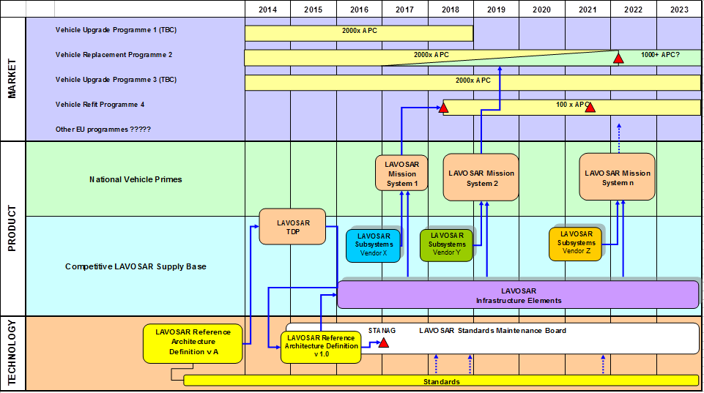
Study Results - 4. Business Case
- Outline Roadmap

Slide 41
Study Results - 4. Business Case
- Business Case
  The three cases assume that 500 APC vehicles are procured as follows:
    10 off in 2016
    240 off in 2017
    250 off in 2018
  The per-vehicle base Subsystem (equipment) price is assumed to be 225K cost units and the infrastructure (cabling) price is 30K per vehicle.
  Remote Weapon Station 250K with associated infrastructure 35K/vehicle
  3 Cases
    EU provides significant investment (10M cost units) in the development and maintenance of a reference Architecture
      Tier 0 Savings - 10% Tier 1 Savings - 12% Tier 2 Savings - 12%
    Industry invests in Standardisation
      Tier 0 Savings - 0% Tier 1 Savings - 8% Tier 2 Savings - 11%
    Higher Volumes (more competitve pricing)
      Tier 0 Savings - 11% Tier 1 Savings - 12.5% Tier 2 Savings - 12%

Slide 42
Whole Life Consideration
Crude assessment based upon 5000 systems across 10 member states.
  Baseline - each pMS continues with its own national approach procuring blocks of 500 vehicles with 10 role-specific fits
  European (LAVOSAR) approach - each pMS purchases the same number of vehicles (but at the reduced acquisition cost) and then support and training costs are reduced as indicated in Table 4‑18.

Slide 43
Study Results - 4. Business Case
- Summary
  Qualitive statements were developed but robust quantitative statements concerning financial benefits were not possible due to the limited input from the government questionnaire.
  A LAVOSAR approach was estimated, using rudimentary assumptions on costs and savings, to potentially provide between 10% and 24% whole life cost savings for a vehicle fleet. (The higher figure assumed a European common procurement of around 5000 vehicles with standardised electronic architecture.)
  Substantial savings could be achieved by the proposed software framework if rigorously standardised and maintained.
  An “App Store” approach, built upon precise open standards, may improve the software provision.
  Significant operational benefits are more significant than cost savings
  With the low number of vehicle procurement in the military field, industry would be reluctant to fund the entire development, establishment and maintenance of all standards necessary and sufficient for an App Store approach.

Slide 44
Study Results
Operational Aspects

Slide 45
Study Results - 5. Operational Aspects
- Summary
  Already been discussed in Normative Framework
  The operational views identified by the normative framework were used as the basis for defining the system reference architecture.
  The main Mission System users will be Commander, Driver, and Gunner.
  Inter-Vehicle information exchanges are required by some EU member states - but there is no coordinated approach across member states. Doctrine differences may need to be resolved to enable multi-national collaboration between small operational groups.
  Local information and consolidated battle information need to be considered separately (fast local information with higher data throughput requirements against slower and more abstract information which is consolidated over many sources.
  Different security levels are required for a reference architecture covering all types of possible applications.

Slide 46
Study Results
Standards

Slide 47
Study Results - 7. Standards
- Complete List of Categories for Potentially Relevant Standards
  General Standards
  Intelligence Surveillance and Reconnaissance (ISR)
  Command, Control, Computer, Communication and Intelligence (C4I)
  Software Infrastructure
  Human Machine Interface
  Video Related Standards
  Sensor Interface
  Built-in-Test (BIT) and Health and Usage Monitoring System (HUMS)
  Safety
  Security
  Environment
  Data Network – Ethernet: Physical
  Data Network – Infrastructure
  Data Network – Subnets and Routing
  Data Network – Ethernet: Protocol Standards
  Data Network – Ethernet: DefStan 00-82
  Web Services
  Virtual Private Networking
  Data Network - CAN
  Point-to-Point Exchange
  Radio Communication
  Power Infrastructure
  Mechanical Infrastructure
  Support Infrastructure
  Supporting Standards
  Embedded Computing - Form Factors & Technology Standards

Slide 48
Study Results - 7. Standards
- Extract of produced Standards Tables
Video Related Standards
Subcategories | Std Type | Std # | Part | Ed | Title
 | UK DEF STAN | 00-82 |  | 2+ | Vetronics Infrastructure for Video Over Ethernet (see note 8.1)
 | NATO STANAG | 4697 |  |  | Platform Level Extended Video Standard (under ratification)
 | NATO AEP | 79 |  |  | Platform Level Extended Video Standard
Formulae | VESA | GTF |  |  | Video Electronics Standards Association Generalized Timing Formula
Timings | VESA | CVT |  |  | Video Electronics Standards Association Coordinated Video Timings (VESA-2003-9)
Encoding | ITU-R | BT.601 |  |  | Encoding Parameters of Digital Television for Studios
 | ISO/IEC | 14496 | 2 |  | Information technology -- Coding of audio-visual objects (MPEG-4)
 | ISO/IEC | 15444 |  |  | Information technology — JPEG 2000 image coding system
 | ISO/IEC | 10918 |  |  | Information technology – Digital compression and coding of continuous-tone still images (JPEG)
 | H.264 |  |  |  | Video compression standard (same as MPEG-4 Part 10)
4:2:2 Video | ITU-R | BT.656 |  |  | Interfaces for Digital Component Video Signals in 525 line and 625 line Television Systems operating at the 4:2:2 level of Recommendation ITU-R BT.601 (Part A)
HDTV | ITU-R | BT.709 |  |  | Parameter values for the HDTV standards for production and international programme exchange
 | ITU-R | BT.1120 |  |  | Digital interfaces for HDTV studio signals
Analogue TV | ITU-R | BT.1700 |  |  | Characteristics of composite video signals for conventional analogue television systems
Picture Data | SMPTE | 274 |  |  | Television - 1920 x 1080 Image Sample Structure, Digital Representation and Digital Timing Reference Sequences for Multiple Picture Rates
 | SMPTE | 296 |  |  | Television - 1280 x 720 Progressive Image Sample
RTSP | RFC | 2326 |  |  | Real Time Streaming Protocol
RTCP | RFC | 3550 |  |  | Transport Protocol for real-time applications
 | ISO | 22311 | annex A |  | Societal security -- Video-surveillance -- Export interoperability
CCIR | NATO STANAG | 3350 | B and C |  | Analogue Video Standard for Aircraft System Applications
SDI | SMPTE | 259 |  |  | Serial Digital Interface (SDI)
HD SDI | SMPTE | 292 |  |  | Bit-Serial Digital Interface for High Definition Television
Software Infrastructure
Subcategories | Std Type | Std # | Part | Ed | Title
Data Model
 | UK DEF STAN | 23-09 |  | V 2.0 | GVA Data Model (in development, current baseline: v2)
Middleware
 | OMG DDS |  |  | 1.2 | DDS API
 | OMG DDS |  |  | 2.1 | DDS Interoperability Wire Protocol (Real-time Publish-Subscribe Wire Protocol)
 | OMG DDS Xtypes |  |  |  | DDS Extensible and Dynamic Topics Types for DDS (DDS-XTypes)
 | OMG UML DDS Profile |  |  | 1 | UML Profile for Data Distribution
 | OMG DDSi |  |  | 2009-01-05 | DDS Interoperability Wire Protocol (DDSI)
 | ISO | 19500 |  | v3.1.1 | Common Object Request Broker Architecture (CORBA)
 | ISO | 19506 |  | v1.3 | Knowledge Discovery Metamodel (KDM)
 | ISO | 19502 |  | v1.4.1 | Meta Object Facility Core (MOF)
 | ISO | 19507 |  | v2.3.1 | Object Constraint Language (OCL)
 | ISO | 19505 |  | v2.4.1 | Unified Modelling Language (UML)
 | ISO | 19503 |  | v2.0.1 | MOF 2 XML Mapping (XMI)
Operating Systems
 | IEEE | 1003.1 |  | 2002 | POSIX 1-2008 The Open Group Technical Standard Base Specifications, Issue 7

Slide 49
Study Results - 7. Standards
- Standards Assigned to Architecture

Slide 50
Study Results - 7. Standards
- Summary
  Most of the standards are Ethernet based (other solutions might apply for safety critical systems, e.g. CAN-bus).
  There are emerging standards for safety critical Ethernet but further work is needed to establish these affordably in the land domain.
  Products using current middleware standards are mostly not available for high integrity or safety involved systems.
  A comprehensive list of standards is provided in Section 4.7. of the Final Report
  Closed VICTORY or SCORPION standards may preclude future multi-national interoperability unless appropriate interfaces can be opened to LAVOSAR.

Slide 51
Study Results
Technologies

Slide 52
Study Results - 8. Technologies
- Technology Tree (1/2)

Slide 53
Study Results - 8. Technologies
- Technology Tree (1/2)

Slide 54
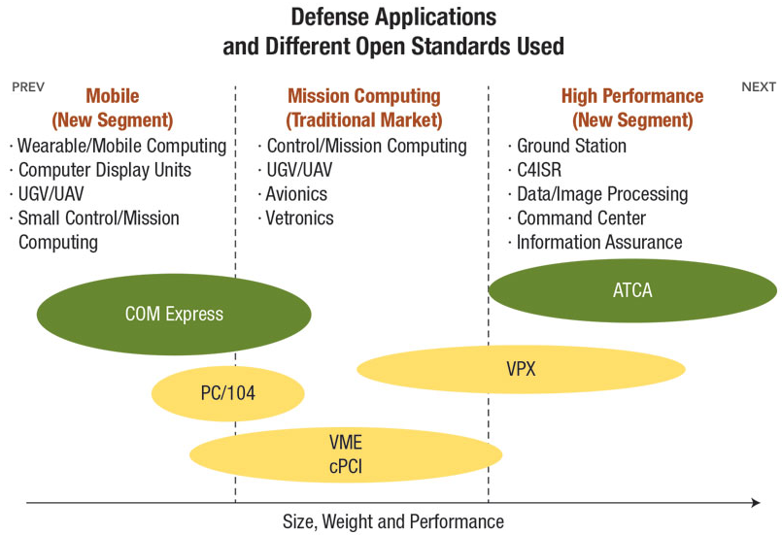
Study Results - 8. Technologies
- Computing Technologies – Packaging

Slide 55
Study Results - 8. Technologies
- Operating Systems
Operating Systems
  Generic Purpose OS : MS Windows, Linux
  Real Time OS : LynxOS, QNX, VxWORKS, Integrity, PikeOS
Virtualization Technology
  HyperVisors
Application to Virtualization
  Secure Partitioning of Operating Systems for Multi Level Security (MLS) & Safety
Secure Operating systems
  PolyXene, SINA, NetTop, SELinux, Thin Client

Slide 56
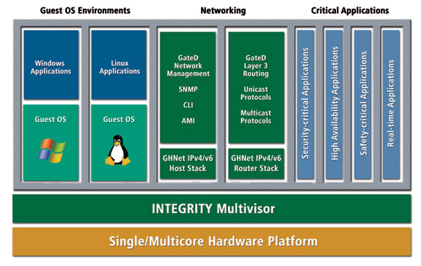
Study Results - 8. Technologies - Hypervisors

Slide 57
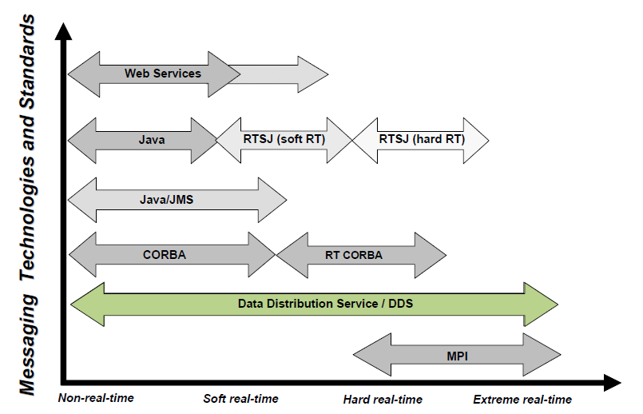
Study Results - 8. Technologies
- Middleware : Data-Distribution and Real-Time
© RTI, Realtime Innovations

Slide 58
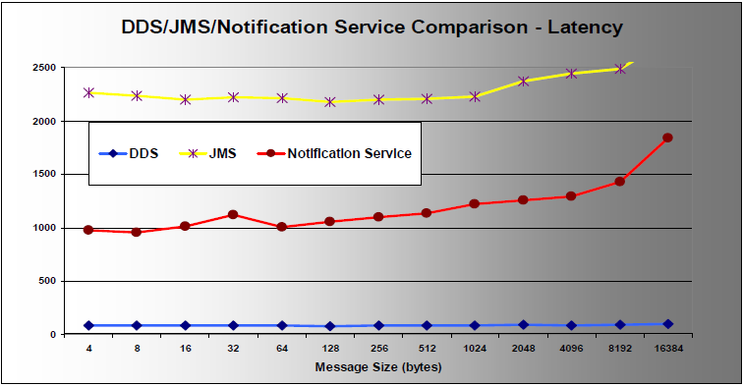
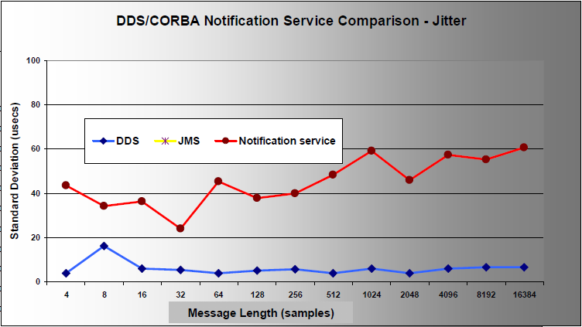
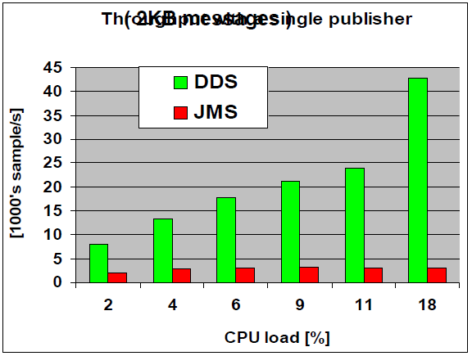
Study Results - 8. Technologies
- Middleware : DDS vs Other Technologies (3/3)
Throughput – Single Publisher
© RTI, Realtime Innovations

Slide 59
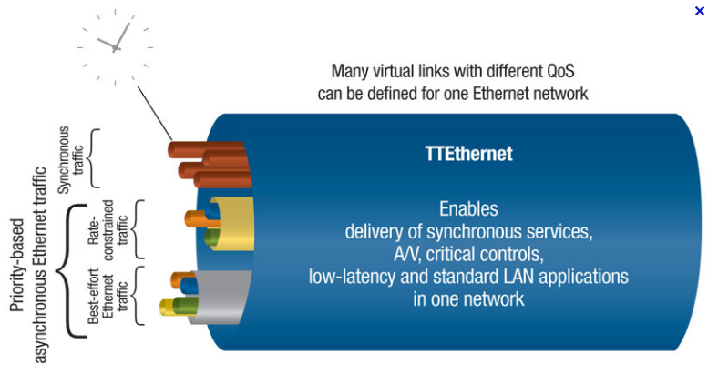
Study Results - 8. Technologies
- Example of Industrial Ethernet : TTEthernet
  Backbone technology Used within last generation airplanes (A380, B787…)
© TTTech Computertechnik AG

Slide 60
Study Results - 8. Technologies
- Technology Assessment Criteria
Universal Criteria
  Standardisation
  Technology Readiness Level
  Technology Endurance
  Cost
  Size, Weight, and Power
Functional & Technology Specific Criteria
  Network
  Storage
  Operating System
  Hypervisors
  Middleware
Domain Specific Criteria
  Data
    Latency
    Security
    Safety
  Video
    Video Performance
    Video Processing
  Audio
    Mean Opinion Score (MOS)
    Latency
  Security
    Risk of Infection
    Evaluation Assurance Level (EAL)
  Safety
    Safety Integrity Level (SIL)
  Build in Test (BIT)

Slide 61
Study Results - 8. Technologies
- Summary
  A large set of potential technologies was identified and listed.
  Often there is no unique solution to all problems. For each problem there might be a specific technology or combination of technologies needed. Several technologies are often available and it is difficult to identify the technology which prevails.
  New technologies, such as hypervisors, were identified which are key enablers for security and safety critical solutions.
  The new technologies are supported both by hardware (processors with hardware virtualisation) and software.

Slide 62
Study Results
Integrated Mission System

Slide 63
Study Results - 6. Integrated Mission System
- General
  “Separation of Concerns” to
    to avoid driving changes into applications upon sub-system or device replacement and
    to avoid driving Interface Control Documents (ICD) data types into applications
  and as main benefit this allows sub-system replacement at lower costs, enabling
    simplified innovation & capability updates
    facilitated obsolescence management
    avoidance of vendor lock-in.
  Altogether, a much finer granularity of interoperability is achieved, i.e. interoperability below the level of Mission System Sub-Systems (“Computing Boxes”) instead of merely interoperability on Sub-System boundaries.
  LAVOSAR suggests various architectural templates which have to be tailored for a specific Target Architecture to allow realization of simple to complex solutions.

Slide 64
Study Results - 6. Integrated Mission System
- Mapping of requested View onto the Sections of the Final Report
  Functional View
    Use Case Views (Section 4.5.2)
    Service Views (Section 4.6.9.1)
  Network and Computer View
    Mission System Infrastructure Views (Section 4.6.6)
    Common Network Services Views (Section 4.6.6.3)
    Data Exchange (Section 4.6.6.2.2)
    Safety (Section 4.6.9.3)
    Mission System Composition contain Network and Computer Views (Section 4.6.7)
  Operating System and Middleware View
    Data Exchange (Section 4.6.6.2.2)
    Safety and Security Approach (Section 4.6.9.3)
    Structure (Section 4.6.9.2)
  Computer Program View
    Structure (Section 4.6.9.2)

Slide 65
Study Results - 6. Integrated Mission System
- Bus Centric System Approach

Slide 66
Study Results - 6. Integrated Mission System
- Mission System Infrastructure (Example)

Slide 67
Study Results - 6. Integrated Mission System
- Mission System Services

Slide 68
Study Results - 6. Integrated Mission System
- Architectural Segments with Key Interfaces

Slide 69
Study Results - 6. Integrated Mission System
- Common Infrastructure Approach

Slide 70
Study Results - 6. Integrated Mission System
- Data Model

Slide 71
Study Results - 6. Integrated Mission System
- Data Model

Slide 72
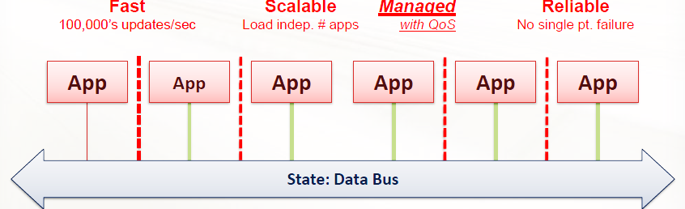
Study Results - 6. Integrated Mission System
- Data Exchange Mechanism
Data Distribution Service (DDS)
  Open standard, standardized by OMG, including API standardization as well as wire protocol standardization (real time publish subscribe - RTPS protocol)
  Conceptually maintains a global data space based upon high performance software data bus with data centric publish-subscribe communication, leading to decoupled sub-systems without single points of failure.
  Low latency and low jitter and support for >>100K messages/sec
  Scalability, independent of number of participants
  Extensive Quality of Service (QoS) management

Slide 73
Study Results - 6. Integrated Mission System
- Network Topology
Choose Network Topology
according to the need.

Slide 74
Study Results - 6. Integrated Mission System
- Mission System Integration Example

Slide 75
Study Results - 6. Integrated Mission System
- Mission System Integration Example (incl. Communication Lines)

Slide 76
Study Results - 6. Integrated Mission System
- Integrated Mission System Layer View

Slide 77
Study Results - 6. Integrated Mission System
- Mission Sub-System Internal Structure

Slide 78
Study Results - 6. Integrated Mission System
- Mission Sub-System - Detailed Internal Structure

Slide 79
Study Results - 6. Integrated Mission System
- Example Configuration of IT-Segment

Slide 80
Study Results - 6. Integrated Mission System
- Common Crew Station Software

Slide 81
Study Results - 6. Integrated Mission System
- Security and Safety Approaches

Slide 82
Study Results - 6. Integrated Mission System
- Summary
  The large number of identified standards, best practices and technologies was used to develop the resulting mission system architecture.
  Concepts have been developed rather than detailed specifications.
  The FACE™ reports highly influenced system architecture and helped to guide the software architectural approach towards APIs at different layers (application, transport level, platform specific level, input/output level, operating system). The Layer approach decouples hardware and transportation from the applications.
  Framework adopted from FACE™ allows modular software plugins (Apps) which may be installed and distributed in the Mission System network according to the specific needs (e.g. depending on latency requirements, data throughput, network topology).
  An APP Store with Apps to be distributed throughout a homogenous system is key to improve quality and to reduce price at the same time.
  Levels with different innovation speeds were identified and a solution for decoupling was developed.
  The proposed architecture offers solutions for different scales, communication lines and computer systems.
  Proposals and templates for handling security and safety issues were presented (to be mentioned especially: a certified hypervisor).

Slide 83
Study Results
Specifications and Design Guidelines

Slide 84
Study Results - 9. Specification and Design Guidelines
- Design Stages

Slide 85
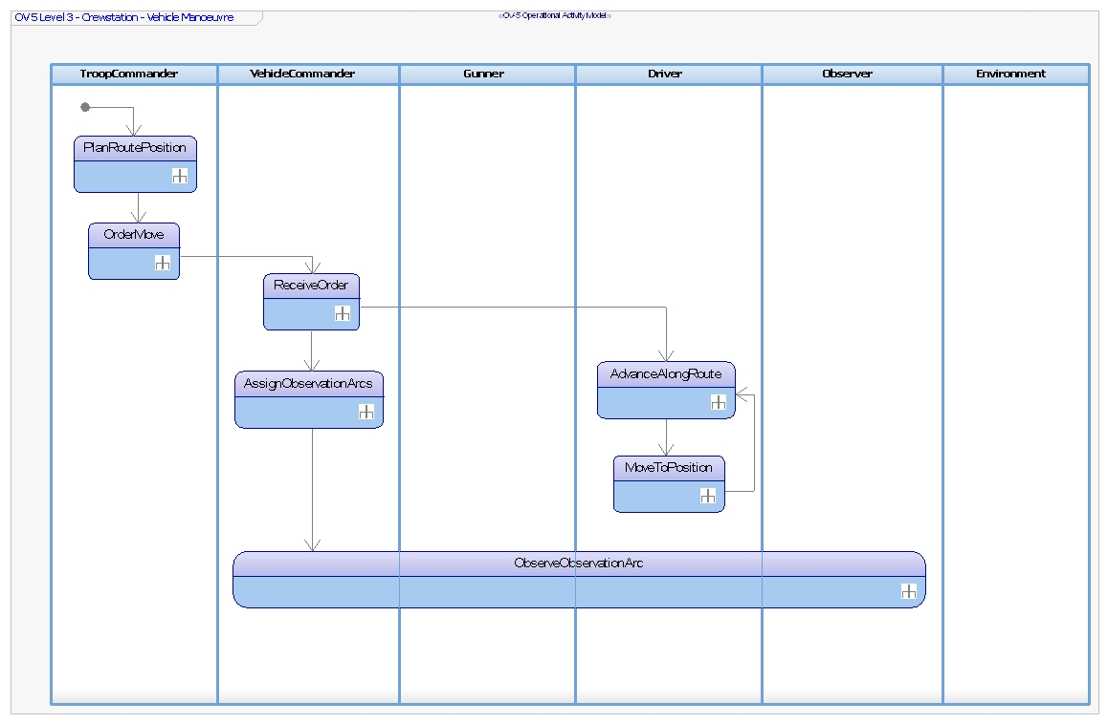
Study Results - 9. Specification and Design Guidelines
- Stage 1 - Operational Analysis

Slide 86
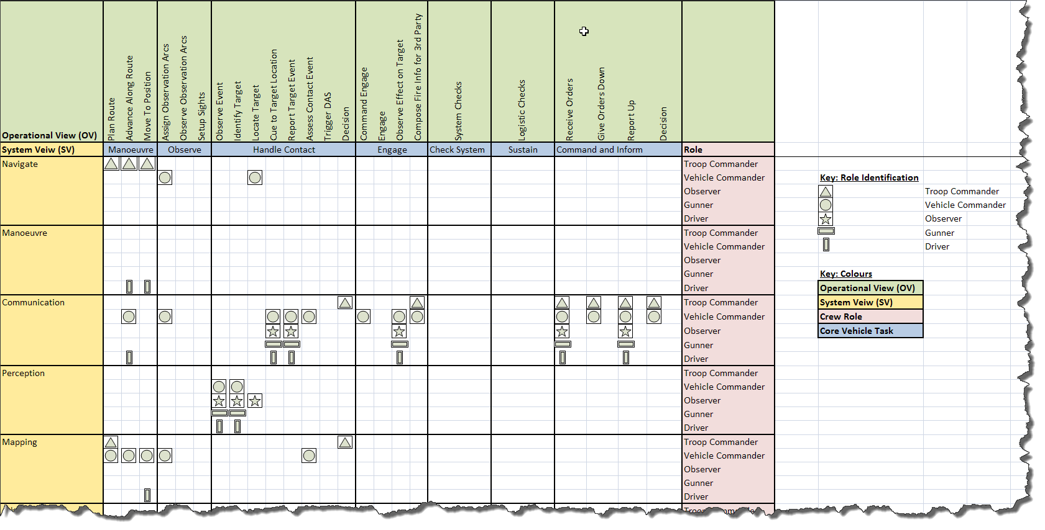
Study Results - 9. Specification and Design Guidelines
- Stage 2 - Operational Task to System Capability Mapping

Slide 87
Study Results - 9. Specification and Design Guidelines
- Stage 2 - Capability / Equipment Mapping

Slide 88
Study Results - 9. Specification and Design Guidelines
- Stage 2 - Identify System Parametric Constraints
  Closed loop subsystems
    Identification of targets
    Hard Timeline tracking between sub-systems
  Security levels
    Security by physical separation
    Integrated multilevel security buses
      Security by encryption - Encrypted bus
      Security by encryption - Encrypted data
  Logical buses
    Video & Voice
    Status & Control
    Secure Data
    Safety Critical Data
  Realtime performance
    Maximum latency in network message delivery
    Video streaming
  Network bandwidth
    Video Format
    Video channels
    Data Throughput
  Network Infrastructure
    Network partitions (physical/logical)
    Network gateways (internal/external)
  Power infrastructure
    Distributed power
    Multiple power buses
    Different voltage supplies

Slide 89
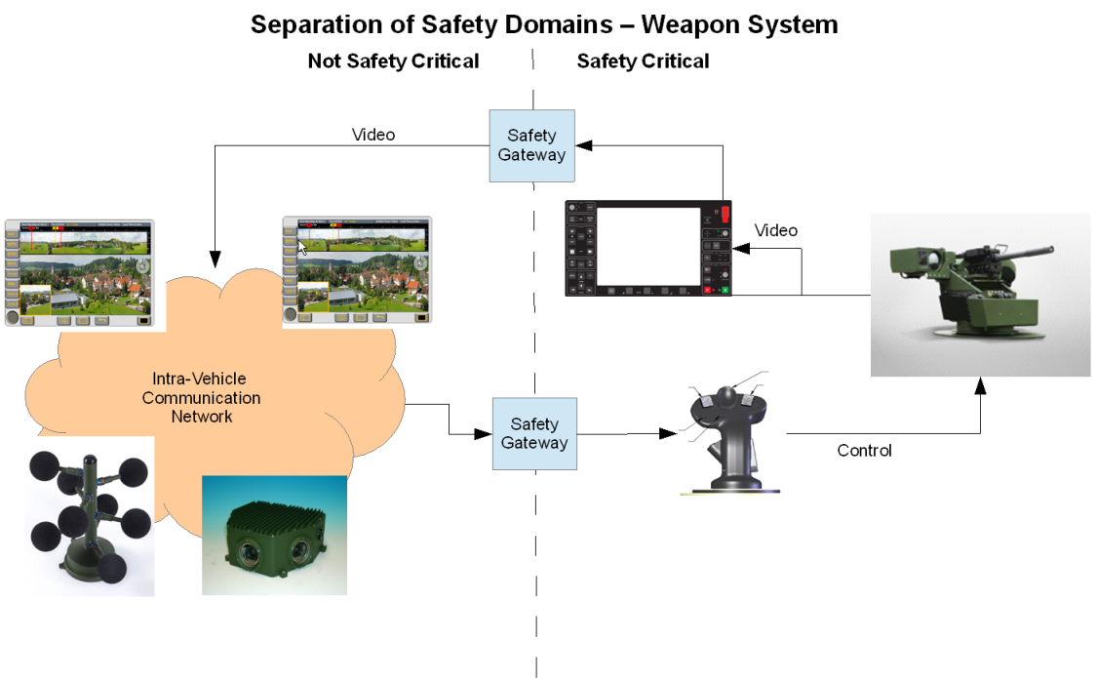
Study Results - 9. Specification and Design Guidelines
- Stage 2 - Select Candidate Reference Architecture
  Number and type of logical data buses
  Number and type of power buses
  Approach to safety
  Approach to security
  Containment of any Real-time Performance
  Understanding the Network infrastructure needs
    Number of nodes/ports
    Gateway interfaces
    Data throughput
    Protocols

Slide 90
Study Results - 9. Specification and Design Guidelines
- Stage 3 - Defining Target Architecture
  Logical Architecture
    Component specifications
    Component interface specifications
      Including Data Models
    Component interactions
    Connection mechanisms and protocols
    Contextual information/rational
  Physical Architecture
    Where and how the components are deployed
      On what hardware
    Network capabilities
      Bandwidth, physical types
    Processing specifications
      CPU types, hypervisors, embedded, high performance, GPU’s
    Hardware requirements
    Contextual information/rational

Slide 91
Study Results - 9. Specification and Design Guidelines
- Stage 3 - DDS Domains within a complex system

Slide 92
Study Results - 9. Specification and Design Guidelines
- LAVOSAR App Store Approach
  Reference Architecture
    architectural templates
    interface descriptions
    detailed description and functional requirements of the architectural segments
  Software Design Guidance Document
  Software Components
  Software Infrastructure
  Development Environment (Software Developer’s Tool Kit)
  Conformance and Certification Guide
  Conformance Test Suites
  Library and Application Store (“App Store”)

Slide 93
Study Results - 9. Specification and Design Guidelines
- App Store
LAVOSAR App Store
  contain Apps supporting plug/configure/play within a wider target system
    Portable Components
    Platform Specific Services
  Apps are
    documented
    tested
    certified
  may be purchased/licensed
  previous experience section

Slide 94
Study Results - 9. Specification and Design Guidelines
- Security
  Today, Security is a mature Capability at NATO Head Quarters or stationary Command Posts. Not mature yet at tactial level
  Head Quarters
    most data is sensitive
    all operators are cleared
    effort is spent for setting up infrastructure
    for quite some time, are digitized with internet technology with worldwide communication capabilities (vulnerable for cyper-attacks)
  Vehicles
    Requirements formulated for Head Quarters are often unrealistic for
      Crew
      Equipment
      Handling
    most data is very detailed and becomes irrelevant after a short period
    often only the commander is cleared
    up to a few years ago, only voice communication on military radios. Digitization only recently

Slide 95
Study Results - 9. Specification and Design Guidelines
- Security - User Roles and Security Levels
Role | Level of security in vehicle | Rationale
Commander | Elevated | Access to order, reports and full shared situational awareness
Gunner | Medium | Assumption: BFT, tracks and some information (sector, area) can be used at unclassified level
Driver | Medium | Assumption: BFT, some information (waypoints and route status) can be used at unclassified level
Specialist | Medium | Assumption: BFT, tracks and some information (sector, area) can be used at unclassified level
Observer | Low | Only unclassified information
Passenger | Low | No or only unclassified information
Mission Loader | Elevated | This role provides all the cryptographic keys, mission relative data and retrieves all the mission recorded data.
Maintainer | Medium | Maintenance should only manage technical unclassified data but information about the followed route could be useful for maintenance
Instructor | Low | No real operation data have to be used during instruction despite those data might have been extracted from some real situations.
Logistic user | Medium | Initialization of Mission System and manage defensive aids

Slide 96
Study Results - 9. Specification and Design Guidelines
- Security
  Top Secret: Information that can cause serious damage to national security.
  Secret: Information that can cause serious damage to national security if publicly available.
  Confidential: Information that could cause damage to national security
  Restricted: Information causing undesirable effects if publicly available.
  Protected/unclassified: Information that must not be disclosed because of personal details etc.

Slide 97
Study Results - 9. Specification and Design Guidelines
- Security - Guideline for Solutions
Level of security | Security function | Security solution
NATO restricted | User authentication | OS features
 | Data protection | OS features and preventing unauthorised mass storage (e.g. USB) Transmission based on NR encrypted device
 | Integrity | OS features Need to know
 | Access control | Security measures (e.g. firewall) based upon security risk assessment
NATO SECRET | User authentication | NR level + physical authentication device
 | Data protection | OS features and preventing unauthorised mass storage (e.g. USB) Encrypted data storage Transmission based on accredited NS encrypted device
 |  | TEMPEST
 | Integrity | OS features Need to know Signature
 | Access control | Security measures (e.g. firewall) based upon security risk assessment Security area

Slide 98
Study Results - 9. Specification and Design Guidelines
- Security Risk Analysis - Attack Tree Example

Slide 99
Study Results - 9. Specification and Design Guidelines
- Security - Classification of Threats
  Stimulus:
    A condition that needs to be considered when it arrives at the system. Stimulus is a class of attack that leads to vulnerable exploitation.
  Source of the stimulus:
    The entity that generated the stimulus (for example, a human or a computer system). The source is the attacker.
  Environment:
    The conditions under which the stimulus occurs; for example when the system is in overload condition. The environment is also determines the type of attacker and his ability to cause attack and damage.
  The target of attack
  Response:
    The activity undertaken after the arrival of the stimulus. A security response is to either prevent the attack or to detect the attack and try to recover from its negative consequences.
  Response Measure:
    Characteristic specific constrain that must be satisfied by the response. The response measure typically measures the reduced probability of attack or reduced impact due to detection and recovery from the attack.

Slide 100
Study Results - 9. Specification and Design Guidelines
- Security - Development of Senarios
Example
  Stimulus:
    Malicious / corrupt data sent from one node to other.
  Source of the stimulus:
    Malicious firmware / application software, communication error.
  Environment:
    Mission system is operational / on a mission.
  Target of attack:
    Mission system capability, E.g. Weapon elevation, safety-critical (SC) protocol.
  Response:
    Integrity of messages, Authentication of nodes.
  Response measure:
    Implementing security on SC mission systems has resource and time constraints.

Slide 101
Study Results - 9. Specification and Design Guidelines
- Security - Security Solutions for Protection
Example
  Firewall
  Intrusion Detection Sensor (IDS)
  Protection against Viruses, Spyware, or Malware
  No or secured USB access
  Host checkers
  Access control and directory services

Slide 102
Study Results - 9. Specification and Design Guidelines
- Security - Security Solutions for Protection
Domain Seperation using a certified KVM-Switch
Physically seperated domains
Domain Seperation using
Vitualisation

Slide 103
Study Results - 9. Specification and Design Guidelines
- Safety
  DefStan 00-55 “Requirements for Safety Related Software in Defence Equipment”
  DefStan 00-56 “Safety Management Requirements for Defence Systems”
  IEC 61508 “Functional Safety of electrical/electronic/programmable electronic safety-related systems”
  ISO 26262 “Automotive Software Standards”
Low Demand Mode
High Demand Mode
Safety Integrity Level (SIL) | Average probability of a dangerous failure on demand of the safety function (PFDavg)
4 | ≥10⁻⁵ to <10⁻⁴
3 | ≥10⁻⁴ to <10⁻³
2 | ≥10⁻³ to <10⁻²
1 | ≥10⁻² to <10⁻¹
Safety Integrity Level (SIL) | Average probability of a dangerous failure on demand of the safety function (PFDavg)
4 | ≥10⁻⁹ to <10⁻⁸
3 | ≥10⁻⁸ to <10⁻⁷
2 | ≥10⁻⁷ to <10⁻⁶
1 | ≥10⁻⁵ to <10⁻⁵

Slide 104
Study Results - 9. Specification and Design Guidelines
- Safety Case Practice
Safety Case consist of
  Objectives
    the safety requirements that must be addressed to assure safety
  Evidence
    information from study, analysis and testing of the system in question
  Argument
    showing how the evidence indicates compliance with the requirements
  Context
    identifying the basis of the argument presented

Slide 105
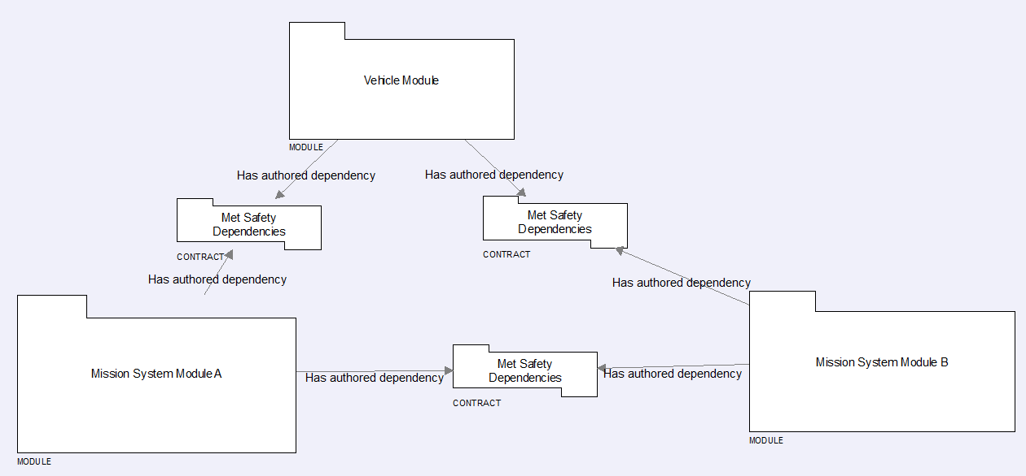
Study Results - 9. Specification and Design Guidelines
- Safety
Modular Safety Cases
  breaking down safety cases in smaller chunks
  advantages
    reduction of complexity
    reuse
    maintainability
    cost efficient qualification when changing or adding parts

Slide 106
Study Results - 9. Specifications and Design Guidelines
- Summary
  A 3-stage approach to specification is proposed with all stages made specific for the LAVOSAR approach:
    Operational analysis (crew roles, platforms, operational constraints).
    Mapping of operational tasks to system functions (system functions, key equipment, system parameters).
    Define deployment specific architecture and system parameters (deploying specific logical architecture, specific system architecture).
  Middleware, such as DDS, enables decoupling, portability, and reuse and makes integration much easier.
  Still defining a common data model standard is a major challenge. A properly designed and managed data model will ease and enable interoperability.
  Data model hosting and maintenance should be part of the software app store.
  Detailed Guidelines, Methods and Proceedures for Safety and Security are given

Slide 107
Study Results
System Acceptance Framework

Slide 108
Study Results - 10. System Acceptance Framework
- Subsystem Verification and System Validation / Accreditation Plan
  Verification procedures which confirm that the characteristics and behaviour of an equipment or system comply with specified requirements (usually done at subsystem level.
  Validation procedures which generates evidence that the capability enabled by the mission system meets the intended use or application. It evaluates the correct operation of the complete mission system on specific use cases. Therefore an operational context is needed.
  Accreditation is a process in which certification of the above is presented.
VV&A Stakeholders

Slide 109
Study Results - 10. System Acceptance Framework
- Verification Methods
Verification:
  Is implementation is correct?
Verification Tools
  requirement traceability matrix
  unique requirements identifier
  test reports
Verification Approaches
  Inspection
    Documentation to confirm compliance with requirements (e.g. - colour, etc.)
  Analysis
    analytical techniques to determine the item will meet the specified requirements (e.g. statistics and quantitative analysis, modelling, simulation, hardware-in-loop, software-in-loop tests).
  Demonstration
    demonstrate functional performance of the system for qualitatively evaluation
  Test
    Testing the system under controlled conditions

Slide 110
Study Results - 10. System Acceptance Framework
- Validation Procedure
Validation:
  Does Implementation comply with the customer and users requirements
Procedure
  Define validation procedures
    to demonstrate that the system is fit for its purpose and satisfies the stakeholder’s requirements
  System readiness
    Ensuring that the systems, operators and dependent systems are ready to conduct validation
  Conduct validation to demonstrate conformance
  Document validation results
  Recommend corrective actions
  Attain stakeholder acceptance

Slide 111
Study Results - 10. System Acceptance Framework
- Verification and Testing Methods

Slide 112
Study Results - 10. System Acceptance Framework
- VV&A Test Bed

Slide 113
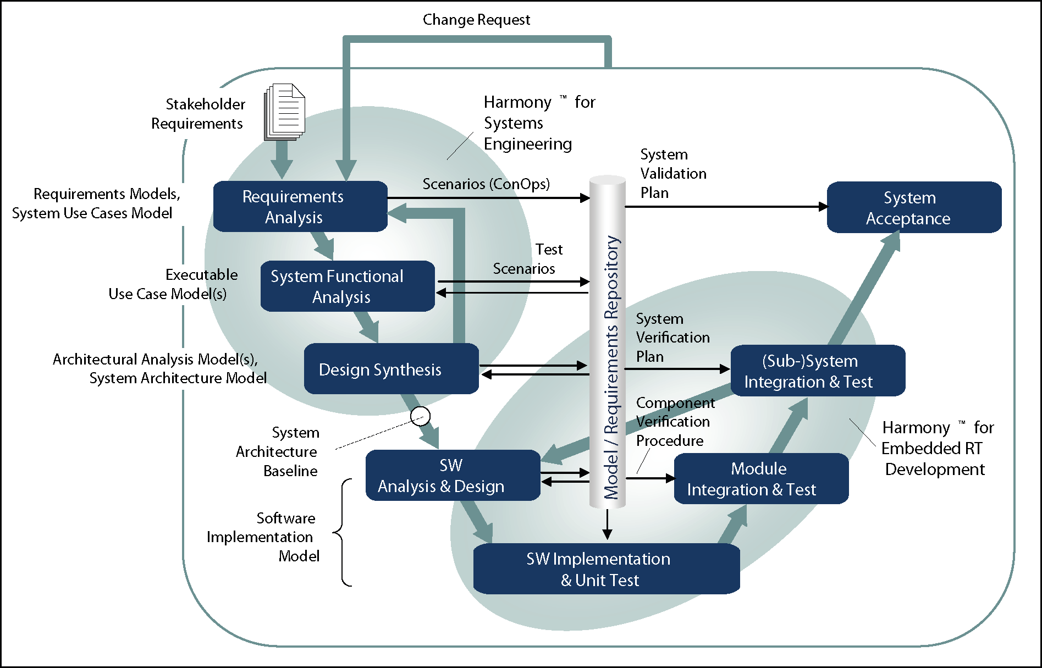
Study Results - 10. System Acceptance Framework
- Verification and Validation in the V-Model

Slide 114
Study Results - 10. System Acceptance Framework
- Assurance
  Definition
    “A documented body of evidence that provides a convincing and valid argument that a specified set of critical claims regarding a system’s properties are adequately justified for a given application in a given environment.”
  Assurance Cases consist of
    safety case,
    certification evidence,
    security case,
    reliability case
  Needs to accompany the development
  Modular Assurance Cases along the modular Mission System Architecture
  Generating Evidence
    System partitioning
    Use of certified network technologies
    Use of certified software libraries
    Use of certified tools
    Proof of adherence to safety and assurance standards
    Proof of following system design life-cycle

Slide 115
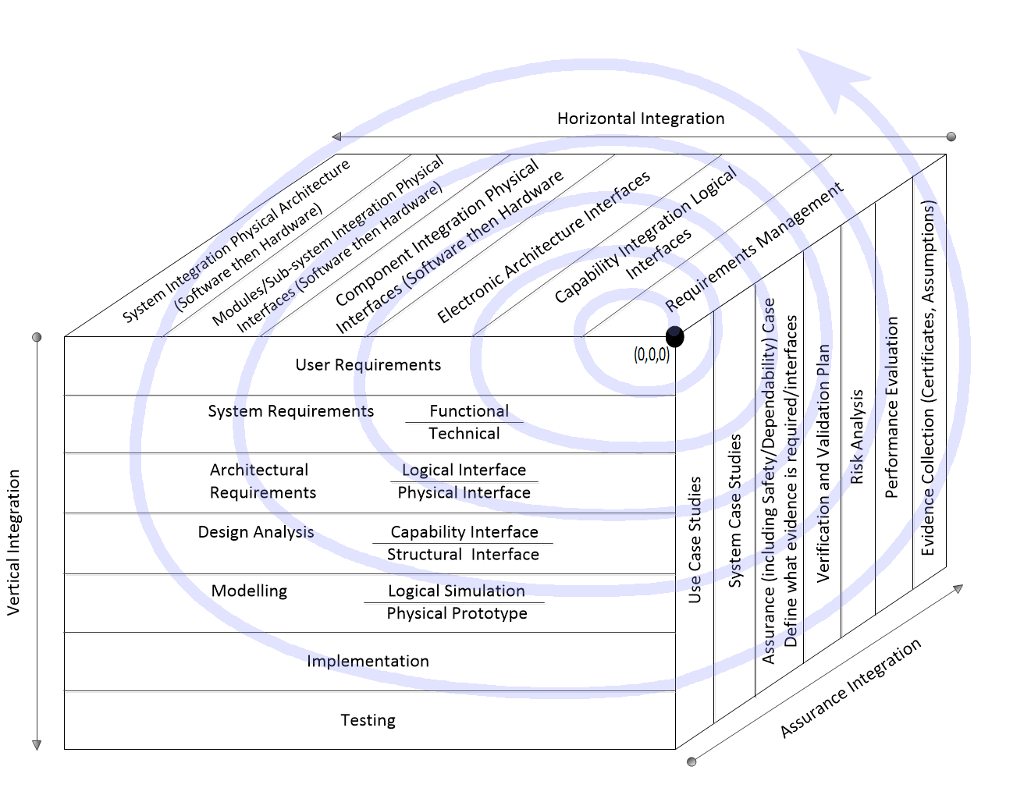
Study Results - 10. System Acceptance Framework
- Horiz. (Capabilities), Vert. (Development) and Assurance Integration

Slide 116
Study Results - 10. System Acceptance Framework
- Roadmap for VV&A
(2015)
Data-centric integration
(2020)
Modular R&A process
(2035)
Capabilities R&A process
Legacy R&A process
Physical sub-systems integration
Partial modular systems
Basic reconfiguration capabilities
Data-centric and Service Oriented integration
Physical and logical sub-system integration
Modular systems
Partial reconfiguration capabilities
Service and Capability Oriented Integration
Capabilities based integration
Abstracted Systems
Capabilities adaptation

Slide 117
Study Results
- 10. System Acceptance Framework - Summary
  Current practices and life cycle models that address system acceptance are briefly described. Validation and verification of mission systems do not differ much from other complex electronic systems.
  Typical system acceptance procedures such as Conformance Testing, Assurance Cases and Test Beds are also described as part of verification and validation plans for mission systems.
  Horizontal and assurance integration are considered since the integration of mission sub-systems needs to be validated.
  Supporting standards such as ISO 15026 (explains system integrity levels, assurance claims) are also referred to.

Slide 118
Summary and Recommendations

Slide 119
Summary and Recommendations
  Comprehensive Open Reference Architecture for Military Land Vehicle Mission Systems as a European Standard is key for the European Member States
    cost efficient approach throughout the whole vehicle life cycle and
    improved operational effectiveness.
  From the Reference Architecture, Target Architectures for the vehicles to be procured would be derived using compatible MOTS Mission Sub-Systems or Components
    provided by a competitive market
    use the necessary interfaces and implement the necessary functionalities
    could be easily integrated into a military vehicle according to the specific needs
  A vehicle which is built according to this standard can sustain the respective state of technology by simply
    adding,
    replacing or
    upgrading sub-systems
  In the same way, a specific or a changing mission need can be satisfied by adapting the set of sub-systems
  Logistics are simplified and exchange of spare subsystems across various types of vehicles and even European nations is possible.

Slide 120
Summary and Recommendations
  Software concepts from FACE™ are very promising
    not covered by UK GVA or NGVA yet
    FACE™ targets the airborne domain where costs have a much high order of magnitude
    approach needs to be developed to make “FACE™” affordable for Land Systems.
  Data Models are key to interoperability.
    syntactics as well as semantics
    prone to continuous changes.
    no sufficient concept for achieving compatibility for different Data Model versions.
    rule set for extending or modifying Data Models
    data mediation approaches which additionally allow the mapping to data models of other domains (e.g. MIP).

Slide 121
Summary and Recommendations
  The business case is important for deciding on the economical importance and should cover at least the next 10 years.
    It was not possible to the study to acquire meaningful numbers or requirements for Mission Systems for this time frame.
    Further effort is recommended here, especially for government input on coordinated fleet training and support policies on the broadest possible European level.
  Raising the new Mission System approaches from national to EU level would increase numbers and competition.
    It is recommended that EDA identifies common fleet procurement possibilities which could be coordinated by EDA and which would benefit from the EU approach.
  Security was identified as a difficult unsolved issue
    security is currently mostly treated nationally and on headquarters level.
    could not acquire any information from EDA about security
    concept development for several Security Domains inside a vehicle with a community of interest needs to be set up in order to achieve an acceptable common solution at EU tactical level.
  Inclusion of the military users as additional stakeholder was not required in the study but would have been useful as they are the persons who need to operate the system and whose tasks are supported by this technology.

Slide 122
Summary and Recommendations
  The major results of LAVOSAR could be standardized as a comprehensive and abstract, higher level concept in order to enable improved standard development on the lower level (c.f. DefStan 23-09 or NGVA).
  Most of the current developments are national
    will lead to different incompatible national standards, e.g. UK GVA, SCORPION, VICTORY
    Such developments may preclude future multi-national interoperability unless the necessary interfaces are published.
    EDA should try to influence nations to make their approaches available.
  NGVA
    NGVA will probably be not equipped with the funding for work
      on such a higher level concept and
      also for additional concepts, such as the software framework,
    EDA could complement these activities (coherent with the NGVA)
Reommended Follow-On Project
  Standard development for EU (ORAMIS)
    to accompany such standard development by demonstrations and experiments which prove that the approach
      is described comprehensively enough,
      is working and proves to be useful and
      provides valuable feedback.

Slide 123
Summary and Recommendations
Further Possible Follow-On Projects
  Development of a demonstrator for the App Store
    with all the aspects of the application to a vehicle
    including the detailed definition of the APIs, the Data Model, specs, etc.
  Development of a proposal for a Validation, Verification and Accreditation (VV&A) organisation and procedures incl. suggestions for a test bed
  Development of further lower layers
    The currently developed LAVOSAR Reference Architecture is abstract.
    A more specific layer needs to be defined in order to make the architecture directly applicable to target applications.
    A part of this layer is already defined in the UK GVA or is currently being defined in the NGVA.
    However, a significant part is still missing or not satisfactorily solved, such as
      interfaces between components of different innovation speeds (operating systems, form factors, etc.),
      data model for data exchange,
      gateways for external communication,
      APIs for the software framework,
      data exchange between vehicles of a convoy or patrol, and
      selection of further standards to be used

Slide 124
Contact
Dr. Norbert Härle
Rheinmetall Defence Electronics GmbH
Defence Electronics - Head of Technology Strategies
( phone: +49 421 457-1503 Ê fax: -4425 È mobile: +49 151 14805589
* e-mail: Norbert.Haerle@Rheinmetall.com

